Slide 1

E-COMMERCE SALES PERFORMANCE
2003-2005 ANALYSIS & GROWTH STRATEGY
UNCOVERING KEY TRENDS AND OPPORTUNITIES

Slide 2

Strong Performance: Total Revenue reached $9.85 Million across all markets.
1
Top Contributors: Classic Cars are our powerhouse product, generating nearly 40% of all revenue.
2
WHAT'S WORKING AND WHERE WE SHOULD FOCUS
Key Growth Period: Sales peak consistently in the 4th Quarter (October - December), confirming a strong holiday season focus.
3
Strategic Opportunity: The USA is our largest market, but growth is strong in other key countries.
4
Recommendation: Focus marketing efforts on Classic Cars and Vintage Cars in our top-performing US states and key European markets to maximize Q4 performance.
5

Slide 3

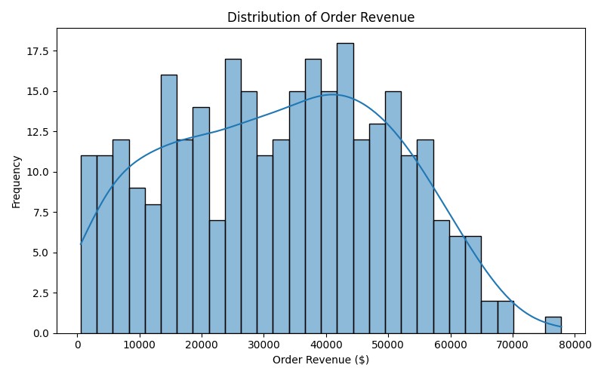
MEASURING SUCCESS:
TOTAL REVENUE AND ORDER VALUE
TOTAL REVENUE: $9,849,165
TOTAL ORDERS: 2,823
AVERAGE ORDER VALUE (AOV): $3,489
Insight: Our products have a high average transaction value, indicating a strong premium/high-value customer base.

Slide 4

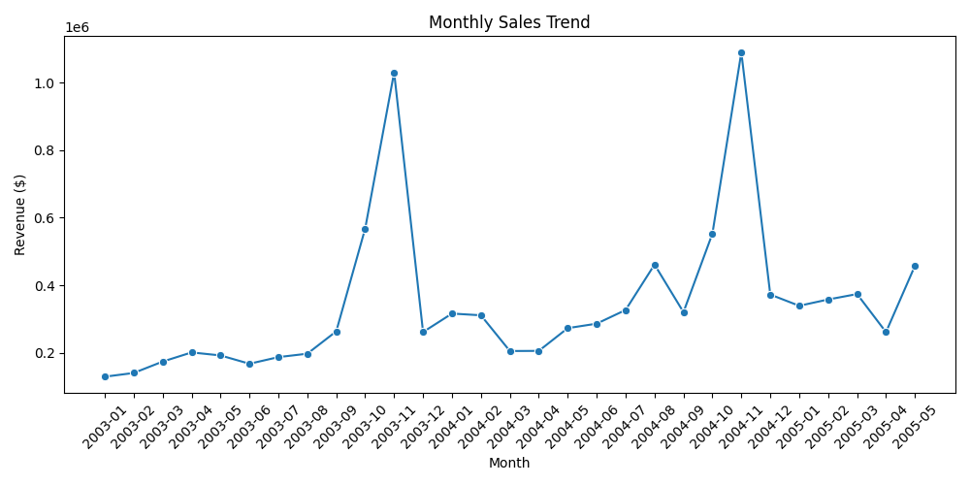
SALES MOMENTUM

Slide 5

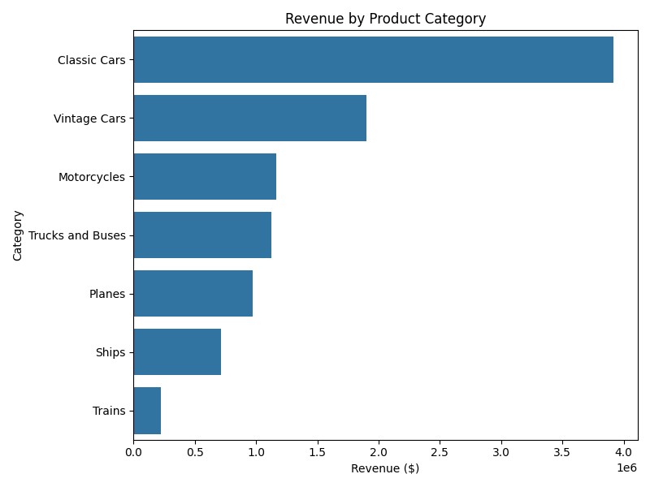
OUR PRODUCT POWERHOUSES
Key Insight:
Classic Cars and Vintage Cars are the foundation of our revenue, contributing over 58% of total sales.

Slide 6
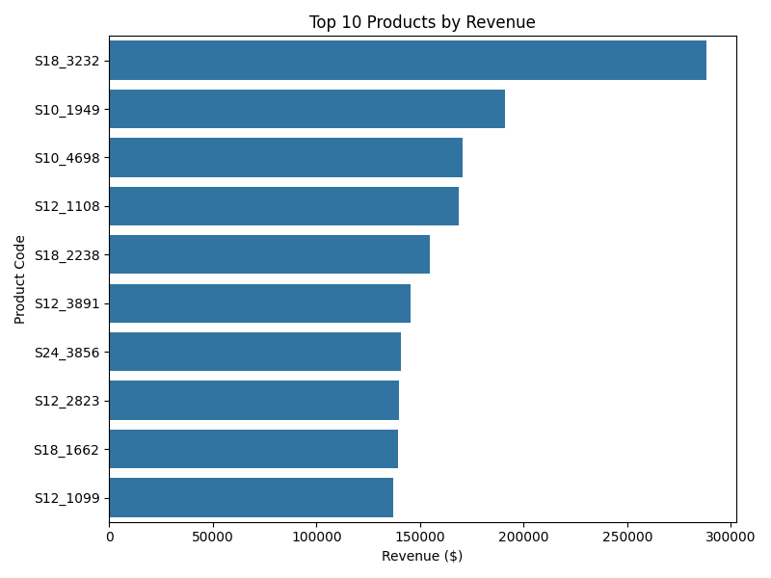
TOP 10 PRODUCTS
Key Insight:
The '1992 Ferrari Daytona' is our single best-selling product, significantly ahead of the rest.

Slide 7

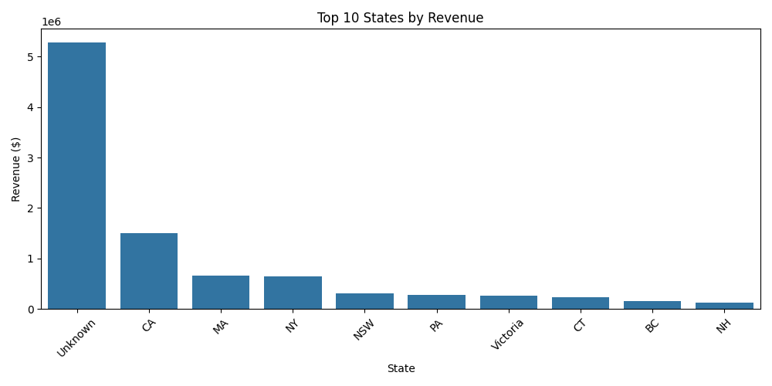
THE GLOBAL MARKET
HIGH-VALUE CUSTOMER LOCATIONS
California, Massachusetts, and New York are our three most critical US markets, responsible for a large share of US sales.

Slide 8



SUMMARY & STRATEGIC RECOMMENDATIONS
Focus Area | Recommendation | Expected Impact
Product | Prioritize Classic & Vintage Cars in all campaigns and inventory decisions. | Maximize revenue by focusing on proven high-demand items.
Timing | Execute the largest sales and marketing push during Q4 (Oct-Dec). | Capitalize on the established peak in customer demand.
Geography | Create hyper-local campaigns for California, Massachusetts, and New York. | Drive higher conversion rates in our highest-value US markets.
Customer | Develop a loyalty program for high-AOV customers (above $5,000) to encourage repeat purchases. | Increase customer retention and lifetime value.

Slide 9

THANK YOU
ANALYST
MANAHIL AHMAD

